Slide 1



NEEDFINDING
MASTERMIND
-THE GAME FOR BLIND
COMPILED BY-ADITYA ABHISHEK , YUKTI GUPTA
, ANVITA SINGH , ISHIKA GUPTA

Slide 2

Outline
Problem Statement
Problem solution
Needfinding Methodology
O Interviewee Overview
O Interview Questions
Interview results
Analysis
Summary

Slide 3
The Problem Statement

Slide 4

Problem statement
GAME FOR THE BLIND
Games have been developed for decades to develop social skills,utilize their leisure time, improve mental skills etc .Games can also be a fun way to learn something.Our agenda was to give the same benefits to visually impaired people by developing games for their enjoyment and entertainment. These games can be be helpful in various aspects to these people. These games not only serve entertainment purpose but also increase various community skills .

Slide 5
Problem Solution

Slide 6
Problem
Solution
GAME FOR THE BLIND - MASTERMIND
‘MASTERMIND” is a computer game program specifically designed for the visually impaired.
The two games currently featured on this software are Sudoku and CodeBreaker. Both games are navigable using a traditional QWERTY keyboard (with a number pad) and use pre recorded audio files to help explain the current game state to the player.

Slide 7
Needfinding Methodology

Slide 8

A graduate student who spends most of the day in college or commuting.
The partially sighted homemaker, aged 34 who is busy all day but wants to devote some time for herself.
Interviewee Overview
1

Slide 9
03. Visually impaired teenage boy who like to spend leisure time in playing games, aged 18.
04. An aged man of 63, who loved playing mindful games but lost his sight in an accident.

Slide 10

01.What is your vision loss percentage?
02.What do you prefer to do in your leisure time ?
03.What kind of games do you prefer playing in your idle time?
04. What are the issues faced while playing the games you choose
Interview Questions

Slide 11
Interview results

Slide 12

Interviewee 1:
“My vision loss percentage is 74 %”
“I prefer reading ebooks with screen reader, singing and playing mindful games that helps boosting my brain activity and creativity
“I like to play games that are more like minded, interesting and most importantly are easy to use and access.”
“The main issue while playing is majorly vision especially while playing board games because of the difficulty in using it and also it is difficult to evaluate as to what is going on in the game”
JONNY KIMSLEY , 22
Graduate Student

Slide 13

Interviewee 2:
“I have lost 54% of my total sight.”
“I love to cook new cuisines for my kids. Being homemaker ,it is important for me to invest my time to such activities which keep me at pace.”
“I love to play games with my children , therefore I prefer games which involves my children to play with me ”
“Being visually impaired it is important for me that these games should be more interactive and have good audio quality”
CHANDRA KALA , 34
Homemaker

Slide 14

Interviewee 3:
“My vision lost percentage is 42%”
“Before losing my vision I loved playing games and used to spend a lot of ,my free time playing games with my friends duand miss doing the same”
“I am more interested in playing games that are winsome and alluring ”
“The major issue faced is the interest while playing the games as it becomes more difficult playing being visually impaired, the fun and finally the engagement while playing.”
APOORV DHOLAKIA , 18
Teenager

Slide 15
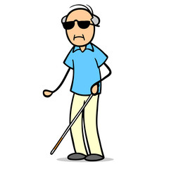
Interviewee 4:
“I lost my complete eyesight during an accident”
“I like to spend time with my family, listening to old songs , reading newspaper and playing various games out there in it ”
“More interested in playing games that are engaging, cognizant and requires thinking for playing them ”
“Apart from being completely visually impaired it is very difficult to find games that are convenient to use and have distinct hardware which is easy to be able interact with game”
DAVID SAMSON , 64
Senior citizen

Slide 16
ANALYSIS

Slide 17
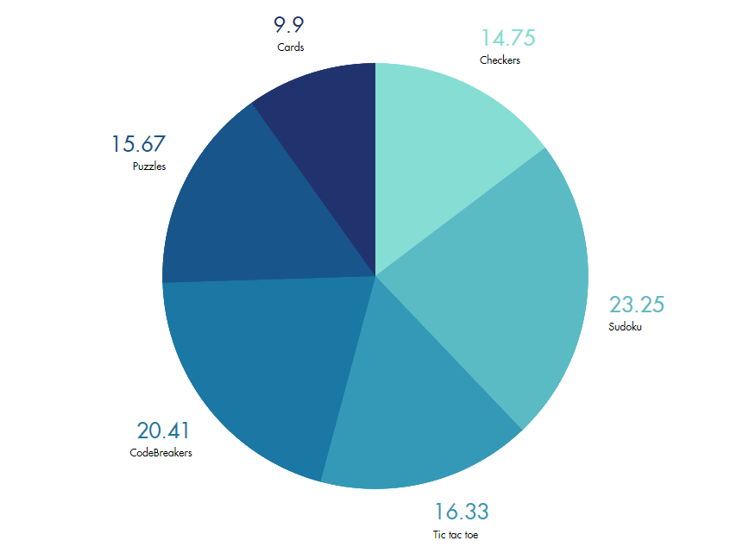
What percentage of blind people are interested in playing various games??
Maximum population that is more than 40% of the people are intent to play mindful games such as Codebreakers and Sudoku

Slide 18
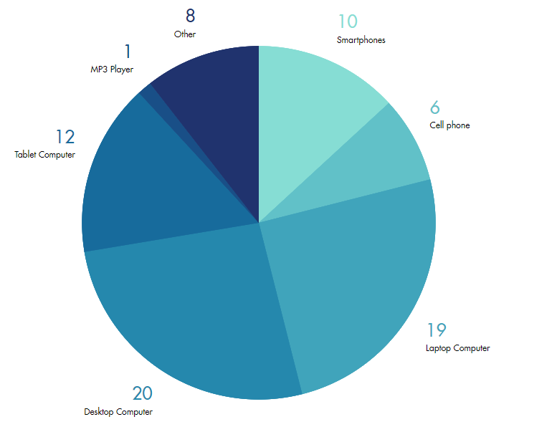
Type of technologies preferred by blind people
People prefer to use mostly computers both desktop and laptops as they have QWERTY keyboards which make these technologies more convenient to use.

Slide 19
Conclusion

Slide 20
Through this project we are trying to develop games which are interactive,entertaining and full of fun
Also this is a very good way of engaging them by involving them in such kind of interactive games
The visually impaired people can play these games during their leisure time for their entertainment
These games can help them in increasing various community skills.

Slide 21
Thank you:)

